Slide 1

Guangdong Chuangwei Electronic Equipment Manufactory
Address：3F, Building E, Tongjin High-tech Park, Guan chang Road, Dalingshan Town, Dongguan City, Guangdong Province, China
Tel：0769-82784046 +86-13922521978
http://www.dgwill.com Email:sales@smtcw.com
Tel：13922521978 / 0769-82784046 http://www.dgwill.com Email:sales@smtcw.com

Slide 2
Guangdong Chuangwei Intelligent Equipment Co., Ltd. is a professional manufacturer of automation equipment. It was founded in 2004 in Chang'an, Dongguan as Chuangwei and was updated to Chuangwei Intelligent in 2021. It is located in Dalingshan Town, Dongguan City, with a registered capital of 6 million RMB and covering an area of 1,500 square meters. Over the years, the company has been dedicated to providing professional cutting and depaneling solutions for electronics factories. It is a high-tech enterprise integrating R&D, production, sales, and service. As one of the earliest cutting equipment suppliers in the domestic electronics industry, the company adheres to the principle of 'customer-centered' and is committed to technological innovation and management optimization. After more than a decade of hard work, the company has established a solid and broad path in the electronics manufacturing industry, providing high-quality cutting equipment for electronics factories. The company offers precise cutting solutions for products in the electronics industry, including PCB, FPC, ceramics, glass, and chips, with various laser cutting machines, milling depaneling machines, and V-groove depaneling machines, and holds 24 cutting patents. Chuangwei has now become a well-known cutting and depaneling brand in the electronics industry, receiving unanimous praise from users. High-quality products and services have enabled Chuangwei cutting equipment to be sold widely both domestically and internationally.
Tel：13922521978 / 0769-82784046 http://www.dgwill.com Email:sales@smtcw.com

Slide 3
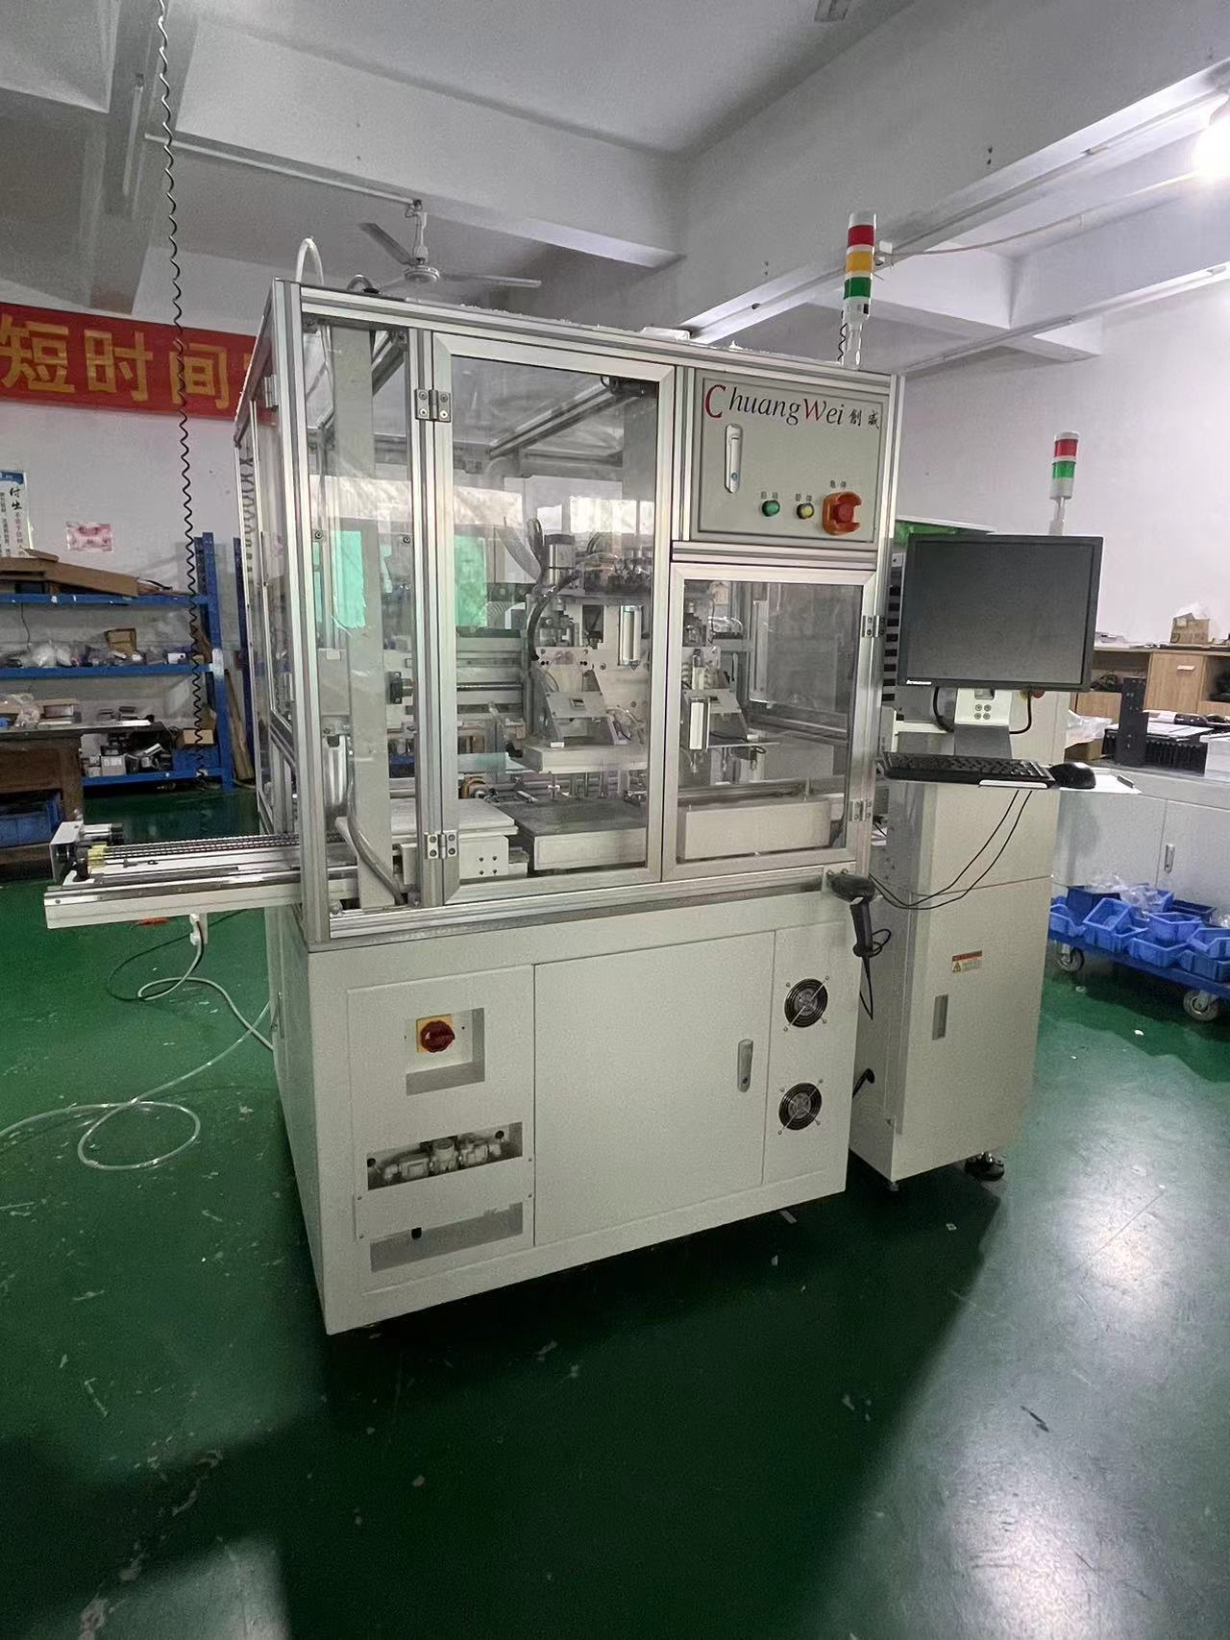
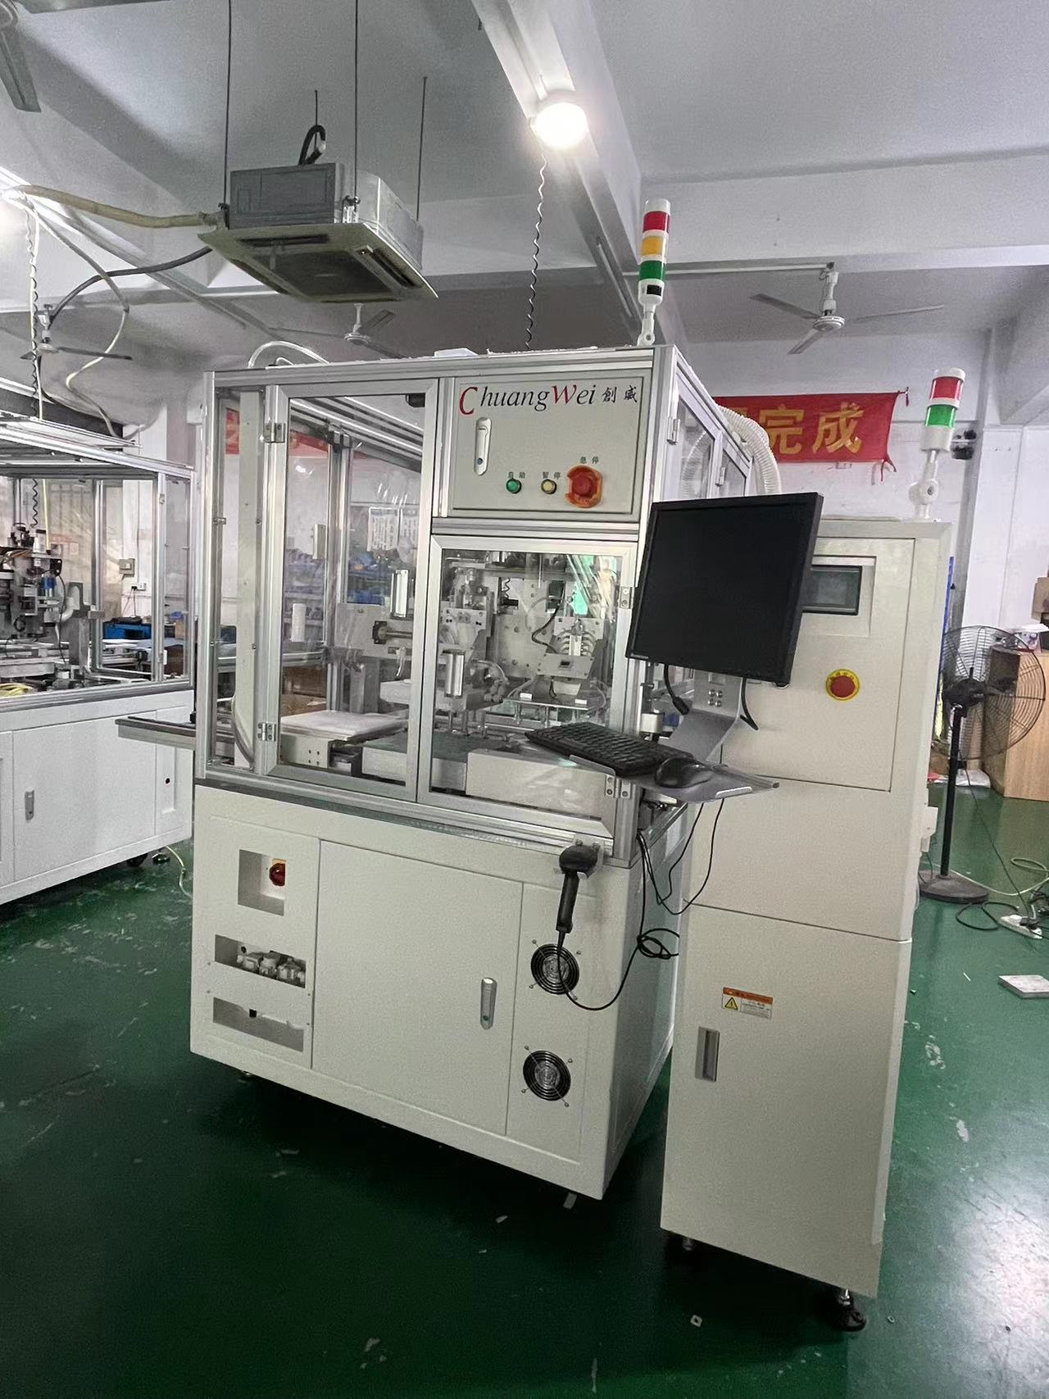
Physical object
Tel：13922521978 / 0769-82784046 http://www.dgwill.com Email:sales@smtcw.com

Slide 4
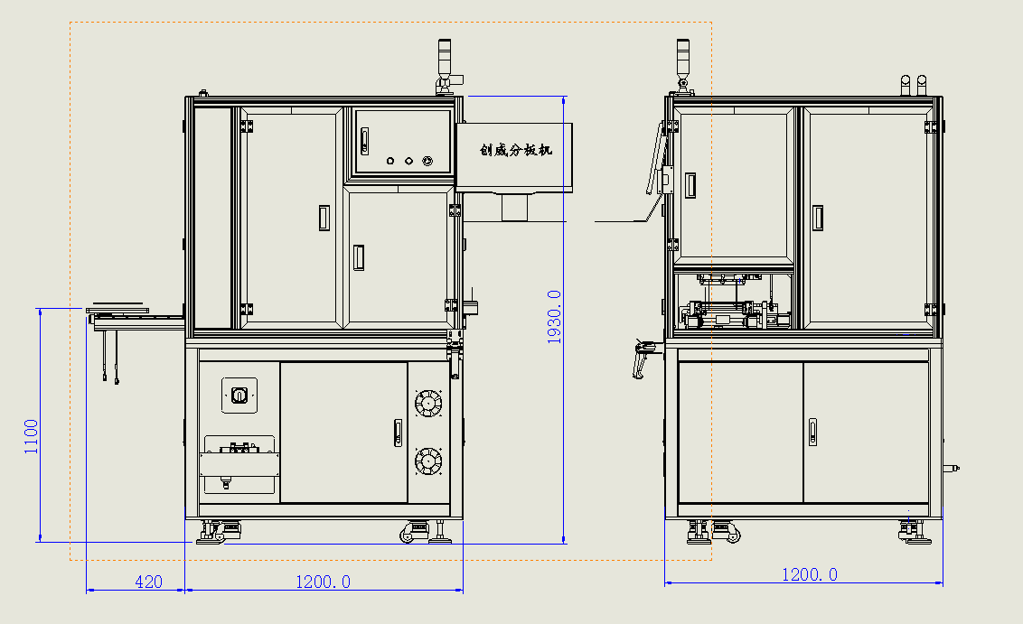
Overall Dimension
LONGTH1200mm WIDTH1200mm HEIGHT1930mm
Tel：13922521978 / 0769-82784046 http://www.dgwill.com Email:sales@smtcw.com

Slide 5
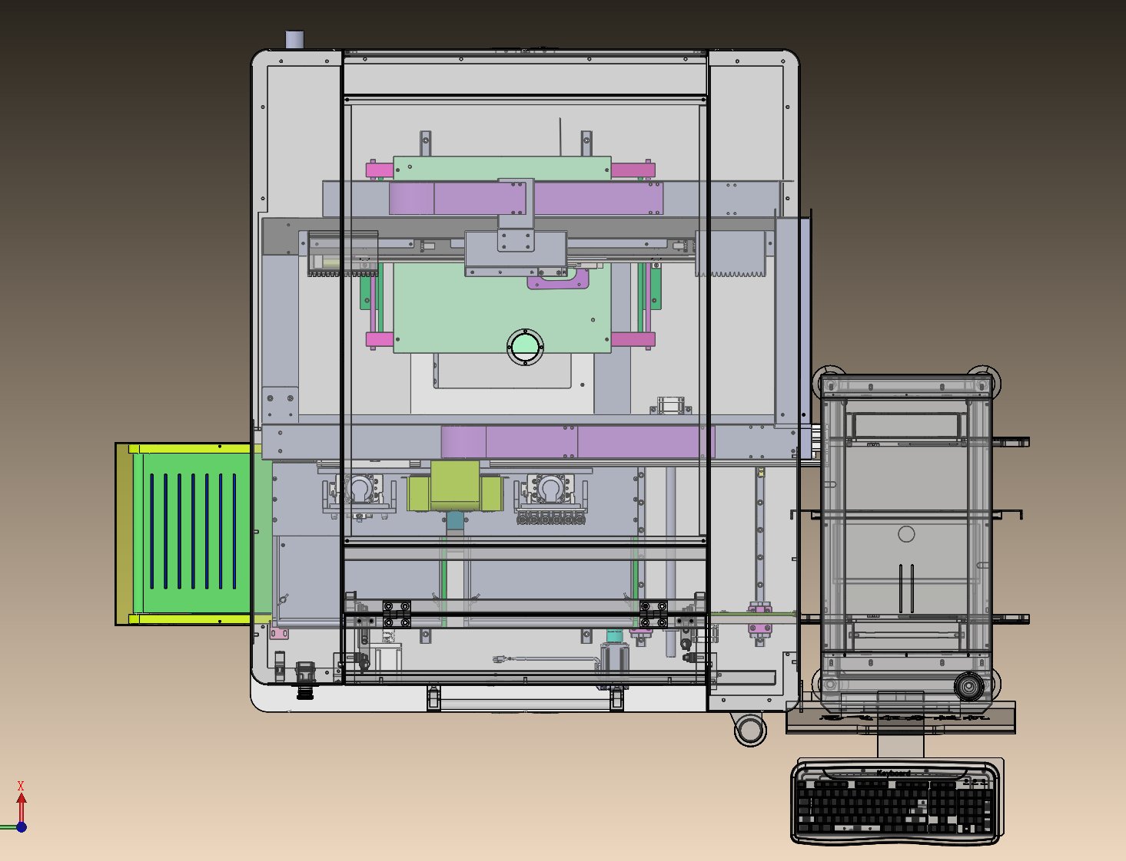
Depaneling Local Map
Slitting
Miniature board loader
The belt line discharges after panel separation
Tel：13922521978 / 0769-82784046 http://www.dgwill.com Email:sales@smtcw.com

Slide 6
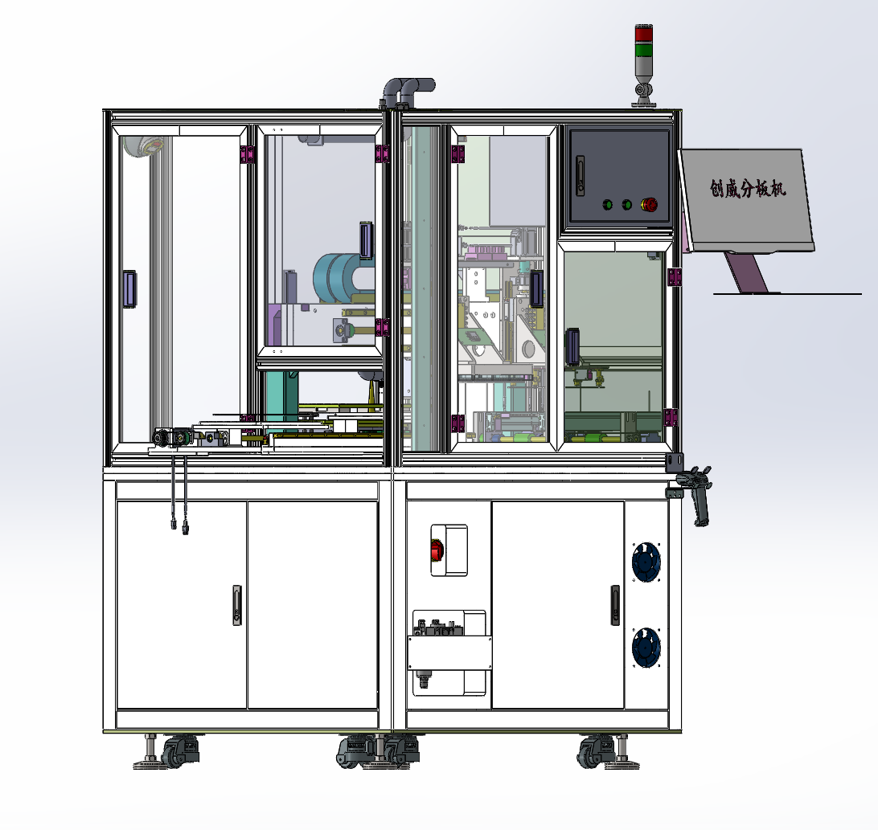
Partial view of Depaneling
Tel：13922521978 / 0769-82784046 http://www.dgwill.com Email:sales@smtcw.com

Slide 7
Online Depaneling workflow diagram
The assembled board enters the PCB depaneling machine.
The Z-axis module picks up the material and places it on the slitting platform.
The slitting platform moves to the slitting position.
START
Automatic board cutting machine
The plating module is placed at the end of the conveyor belt.
(End)
Tel：13922521978 / 0769-82784046 http://www.dgwill.com Email:sales@smtcw.com

Slide 8
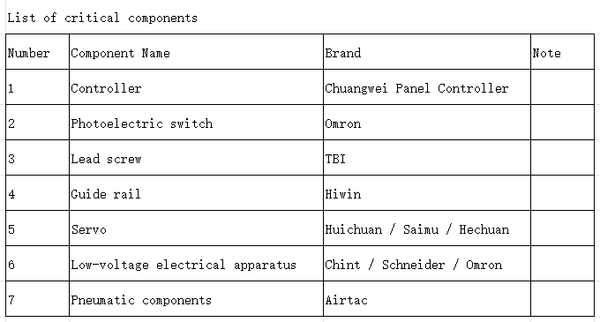
Equipment Configuration Form
Tel：13922521978 / 0769-82784046 http://www.dgwill.com Email:sales@smtcw.com

Slide 9
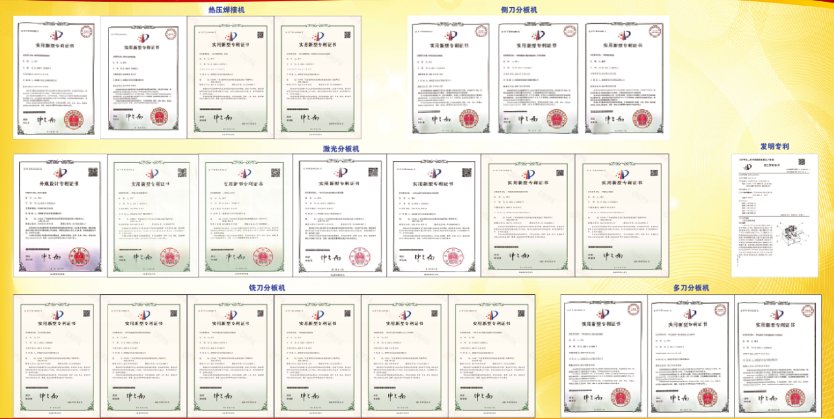
Patent
电话：13922521978 / 0769-82784046 http://www.dgwill.com Email:sales@smtcw.com

Slide 10













Part of cooperative clients
Tel：13922521978 / 0769-82784046 http://www.dgwill.com Email:sales@smtcw.com

Slide 11
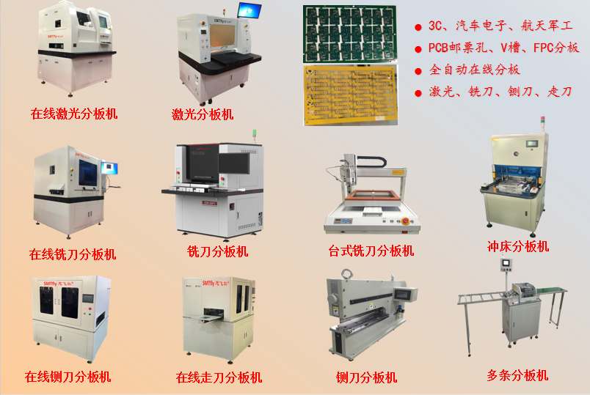
PCB FPC 分板机系列
电话：13922521978 / 0769-82784046 http://www.dgwill.com Email:sales@smtcw.com

Slide 12
Company Advantages Reasons to Choose Us
1、Founded in 2004 in Chang'an, Dongguan as Chuangwei, it was rebranded as Chuangwei Intelligent in 2021. With years of experience and a solid reputation, it is trustworthy.
2、Automate various original manufacturing lines at favorable prices, providing customers with automation solutions.
3、Customize personalized solutions for clients, reduce manual operations, improve quality, and enhance efficiency.
4、24-hour technical support service;
5、Limited-time complaint handling service, respond to customers within half an hour.
Tel：13922521978 / 0769-82784046 http://www.dgwill.com Email:sales@smtcw.com

Slide 13
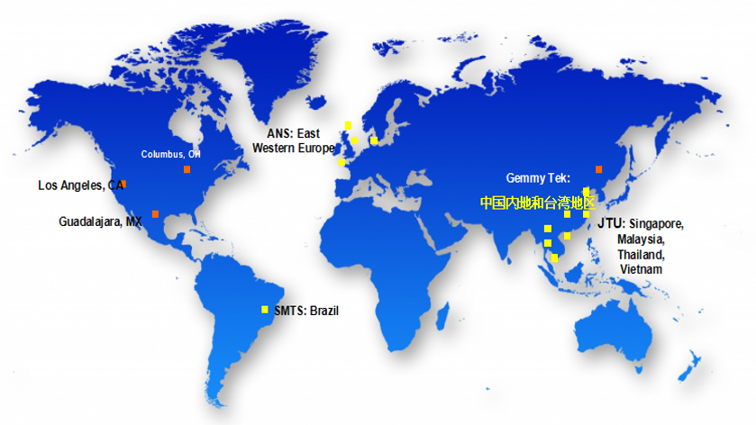
Global sales and service network
Tel：13922521978 / 0769-82784046 http://www.dgwill.com Email:sales@smtcw.com

Slide 14

The End
Thank you for watching
谢 谢
Tel：13922521978 / 0769-82784046 http://www.dgwill.com Email:sales@smtcw.com

